Slide 1
SEWAGE MONITORING SYSTEM
SRIATCHAYA N(73772213203)
THARANEESWARAN S(73772213209)
Guided by : Mohan Raj R (Assistant Professor)
26/12/2026

Slide 2
ABSTRACT
Sewage environments pose serious risks to workers due to toxic gases and hazardous materials present in sewer manholes. Traditional wired monitoring systems, while helpful, suffer from limitations such as poor portability, high cost, and lack of adaptability to confined spaces.
To overcome these challenges, this project proposes a real-time wearable monitoring system that continuously tracks environmental conditions including temperature, moisture, and harmful gas levels.
Using LoRa wireless technology, the system enables long-distance communication between wearable devices and a central control unit for continuous monitoring. When unsafe conditions are detected, instant alerts are sent to workers and management to enable rapid response.
The system is designed to be affordable, portable, and user-friendly, ensuring worker safety without interfering with daily tasks.

Slide 3
NOVELTY OF THE PROJECT
Multi-Gas Detection
Detects multiple toxic gases (CH₄, CO, H₂S, NH₃) for improved safety.
Real-Time Monitoring
Continuously monitors conditions and provides instant updates.
Automatic Ventilation System
Activates exhaust fan automatically when gas levels are high.
Dual Alert Mechanism
Gives alerts through buzzer and wireless communication.
IoT-Based Remote Monitoring
Allows supervisors to monitor conditions from anywhere.

Slide 4
OBJECTIVE
To design and develop a real-time wearable monitoring system for detecting hazardous conditions in sewage and wastewater environments.
To continuously monitor toxic gas levels, temperature, and humidity to ensure a safe working environment for sewage workers.
To implement LoRa-based wireless communication for reliable long-distance data transmission between wearable devices and the control unit.
To provide instant alerts and notifications to workers and authorities when unsafe environmental conditions are detected, enabling quick preventive action.

Slide 5
EXISTING SYSTEM
Traditional sewer monitoring systems use wired sensors and manual inspections to detect hazardous gases, temperature changes, and moisture, ensuring worker safety.
These systems transmit data to control units and trigger alarms when unsafe conditions are detected.
Manual inspections help identify potential hazards but expose workers to toxic gases and hazardous materials.
Existing wired systems are bulky, expensive, and difficult to deploy in confined or hard-to-reach sewer environments, with limited adaptability and real-time monitoring.

Slide 6
DRAWBACKS
Wired monitoring systems are not portable and are difficult to deploy in confined sewer environments.
High installation and maintenance costs limit widespread adoption.
Manual inspections put workers at direct risk from toxic gases and hazardous materials.
Limited adaptability and real-time monitoring capabilities reduce responsiveness to sudden hazardous conditions.
Existing systems may not provide continuous data over long distances or across large sewer networks

Slide 7
PROPOSED SYSTEM
The proposed system introduces a real-time wearable safety monitoring framework for sewage and wastewater treatment environments to protect workers operating in hazardous sewer manholes. The system integrates compact environmental sensing modules within a wearable unit to continuously monitor temperature, moisture levels, and toxic gas concentrations in the surrounding environment.
The wearable unit wirelessly transmits sensed data using LoRa-based long-range communication to a centralized monitoring station. This enables reliable data transmission over extended distances while maintaining low power consumption, making the system suitable for underground and confined spaces. The central unit continuously analyzes incoming data and compares it against predefined safety thresholds.
When abnormal or unsafe environmental conditions are detected, the system immediately triggers real-time alerts to both on-site workers and supervisory personnel. Alerts enable rapid decision-making, evacuation, or corrective action, thereby minimizing health risks and preventing fatal accidents. The system is designed with a portable, low-cost, and user-friendly architecture, allowing seamless integration into routine work activities without causing discomfort or operational interference.

Slide 8
ADVANTAGES
Enhances worker safety by continuously monitoring hazardous environmental conditions in sewage and wastewater environments.
Provides real-time alerts when toxic gas levels or unsafe conditions exceed permissible limits, enabling rapid response.
Enables reliable long-distance communication in confined and underground spaces through LoRa wireless technology.
Operates with low power consumption, allowing extended usage without frequent battery replacement.
Offers a portable and wearable design that does not interfere with routine work activities

Slide 9
MODULES
SENSOR DATA ACQUISITION MODULE
This module is responsible for collecting real-time environmental and physiological data from the sewage working environment. It integrates various sensors such as temperature, humidity, toxic gas sensors (H₂S, CH₄, CO), heart rate sensors, and motion sensors. The collected data provides continuous insight into both environmental hazards and worker health conditions, forming the foundation for real-time monitoring and safety analysis.
WEARABLE DEVICE CONTROL MODULE
This module manages the operation of the wearable monitoring unit worn by sewage workers. It controls sensor initialization, data sampling, and pre-processing using the microcontroller. The module ensures efficient power usage, portability, and uninterrupted operation while workers move across different confined sewage spaces.

Slide 10
MODULES
TOXIC GAS DETECTION AND THRESHOLD ANALYSIS MODULE
This module continuously evaluates gas concentration levels against predefined safety thresholds. When toxic gases exceed permissible limits, the system identifies hazardous conditions instantly. This module plays a critical role in preventing exposure-related accidents by enabling early detection of dangerous sewage gases.
PHYSIOLOGICAL MONITORING MODULE
This module focuses on aligning words within the dataset, ensuring coherence and consistency in the representation of opinions. By aligning words based on their syntactic and semantic relationships, it enhances the effectiveness of subsequent sentiment analysis tasks.

Slide 11
MODULES
MOTION AND FALL DETECTION MODULE
Using motion and acceleration sensors, this module detects abnormal movements such as slips, falls, or sudden impacts. By analysing orientation and acceleration patterns, it helps identify accidents in confined and low-visibility sewage environments, allowing for quick emergency response.
LORA-BASED WIRELESS COMMUNICATION MODULE
This module enables long-range, low-power wireless transmission of sensor data using LoRa technology. It ensures reliable communication between the wearable device and the central monitoring unit, even in underground or remote sewage locations where wired networks are impractical.

Slide 12
MODULES
ALERT AND NOTIFICATION MODULE
This module generates real-time alerts when unsafe conditions are detected. Alerts are provided to workers through vibration signals and to supervisors via the control unit or communication network. The two-phase alert mechanism helps reduce false alarms while ensuring timely warnings during critical situations.
CENTRAL MONITORING AND DATA LOGGING MODULE
This module receives real-time data from multiple wearable devices and displays it on a centralized dashboard. It stores sensor readings for analysis, reporting, and future reference. The module supports decision-making by providing a clear overview of environmental conditions and worker safety status

Slide 13
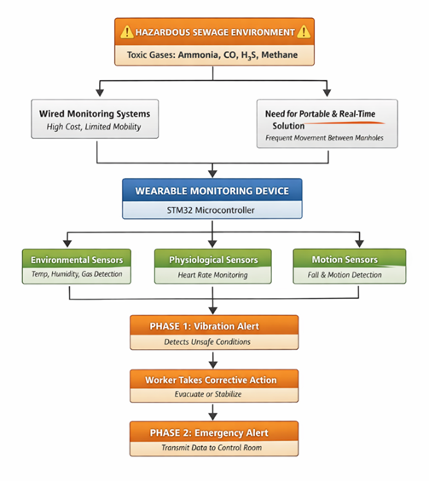
SYSTEM FLOW DIAGRAM

Slide 14
CONCLUSION
In conclusion, the proposed IoT-based sewage quality monitoring system provides a reliable and energy-efficient solution for real-time environmental monitoring.
By integrating decentralized data management with long-range LoRaWAN communication, the system ensures secure, transparent, and continuous data transmission even in remote and harsh environments.
The elimination of single points of failure enhances system reliability, while low-power operation enables long-term deployment of wearable and sensor devices.
Overall, the proposed system offers a scalable, robust, and secure approach to improving safety and quality monitoring in distributed sewage environments.

Slide 15
REFERENCE
[1] B. Siliverstovs, D. Herzer, “Manufacturing exports, sewage exports and growth: conintegration and causality analysis for Chile (1960 – 2001)”, Applied Economics, 2007, pp. 153–167.
[2] “Annual Report of Chilean Sewage 2014”, National Service of Geology and sewage, Chile. ISSN: 0066-5096, 2014.
[3] D. Jimenez, “High altitude intermittent chronic exposure: Andean miners”, Hypoxia and the Brain, 1995, pp.284-91.
[4] H.-Y. Chiu, "Early morning awakening and nonrestorative sleep are associated with increased minor non-fatal accidents during work and leisure time", Accid. Anal. Prev., vol. 71C, pp. 10-14, 2014.
[5] EJ Pino, A Dorner De la Paz, P Aqueveque, “Noninvasive monitoring device to evaluate sleep quality at sewage facilities”, IEEE Transactions on Industry Applications, 51 (1), pp.101-108, 2015.

Slide 16
Thank You !

